Slide 1
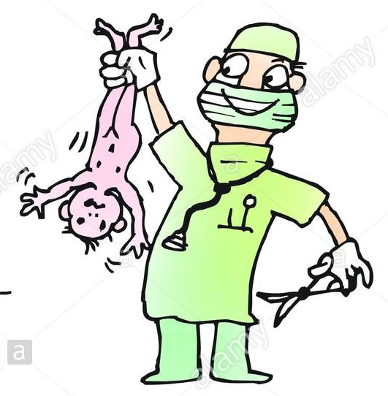
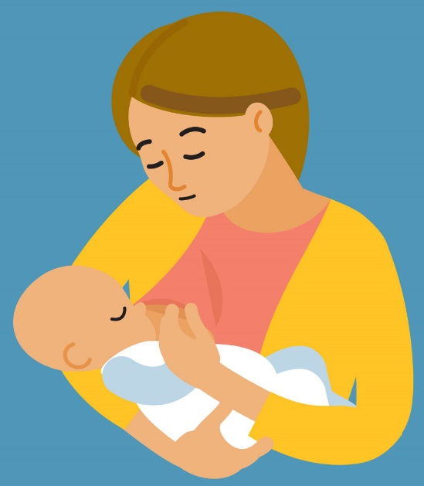
Parturition and Lactation
Prof Deepthi de Silva
Department of Physiology

Slide 2
Lecture outline
Mechanism of parturition
Stages of delivery
Pain in parturition
Post-partum period
Lactation
  Mechanism & hormones

Slide 3
Parturition (child birth)
Pregnancy lasts
270 days after fertilization
OR
284 days after the last menstrual period
* Calculation of Expected Date of Delivery

Slide 4
Mechanism of parturition
Hormonal changes
Sudden rise in oestrogen : progesterone ratio
Oestrogen increases uterine contractility; increases prostaglandin synthesis
PG increase uterine contractility
2. Mechanical changes

Slide 5
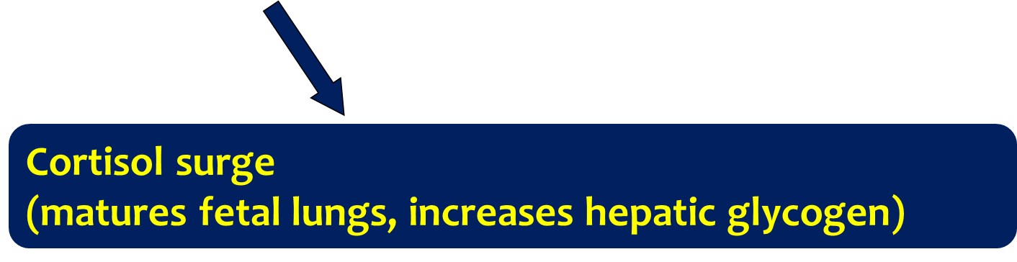
How does oestrogen increase?
Foetus
Placenta
Pitiutary
Adrenal
gland
CRH
ACTH
Androgens
Oestrogens

Slide 6
Mechanical factors
During pregnancy : no contractions
During late pregnancy : irregular uterine contractions ‘Braxton- Hicks’
At time of labor : strong & painful
labor contractions
? Relative decrease in progesterone

Slide 7
Towards end of pregnancy
Increase in number of oxytocin receptors in uterus (myometrium & decidua)
  Stimulated by oestrogen, uterine stretching
Uterus contracts : stretches cervix
  neuroendocrine reflex
  oxytocin release
  stimulates further contraction
Positive feedback

Slide 8
Role of oxytocin
In early labor, levels of oxytocin do not increase, but the existing levels act on the increased no of oxytocin receptors
Actions :
  increases uterine contraction
  stimulates prostaglandin formation
Prostaglandins enhance oxytocin (& oestrogen) induced contractions (positive feedback)

Slide 9
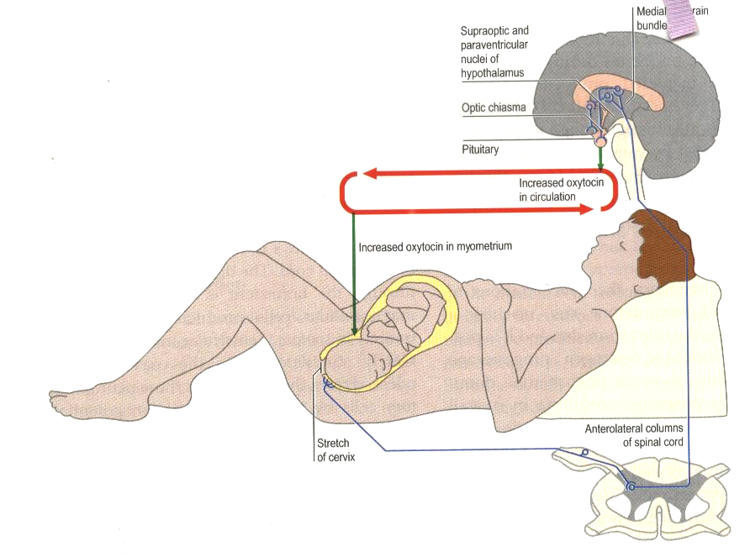

Slide 10
Parturition
Uterine contractions
First stage : dilatation of cervix
Second stage : baby moves down and is delivered
Third stage : Placental separation *
        Cervix fully dilates
* 350 mL blood loss
Uterine contraction
essential to prevent
further blood loss

Slide 11
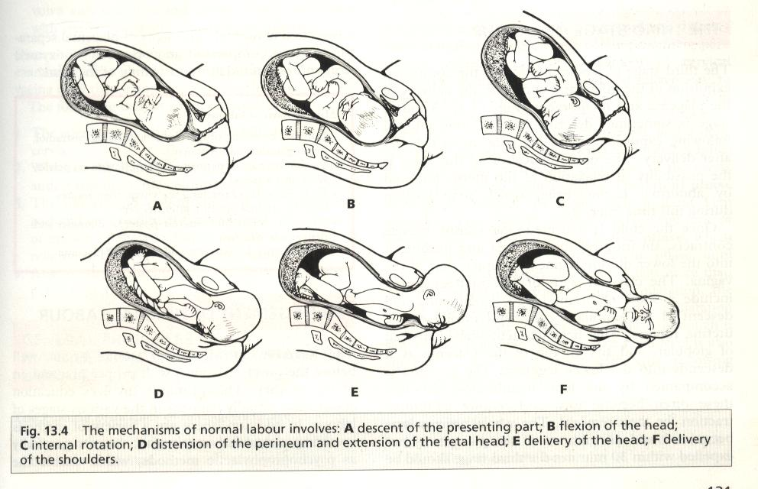

Slide 12
Placental separation (3rd stage)
Uterine cavity reduces in size, shearing the placenta from the uterine wall
Limited bleeding – controlled by local production of vasoconstrictors (prostaglandins)
Expulsion is by uterine contraction

Slide 13
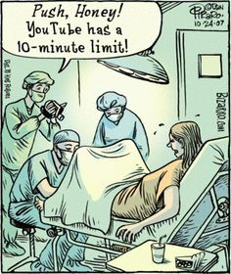

Slide 14
After delivery
Uterus involutes around 4-6 weeks later; due to decreased effect of hormones
Placental site autolyses; results in a vaginal discharge (LOCHIA)
Re-epithelialization of the endometrium

Slide 15
Breast milk secretion
Secretion is stimulated by prolactin
Helped by other hormones
  GH, Cortisol, PTH, Insulin
  provide nutrients as substrates
Suckling
  Stimulates prolactin release
  maintains and augments secretion
Refer – colostrum

Slide 16
Prolactin
From anterior pituitary
Levels rise in pregnancy (5 weeks - birth)
Levels fall in a few weeks after birth
Suckling stimulates a burst of prolactin
Concentration in blood
weeks
birth

Slide 17
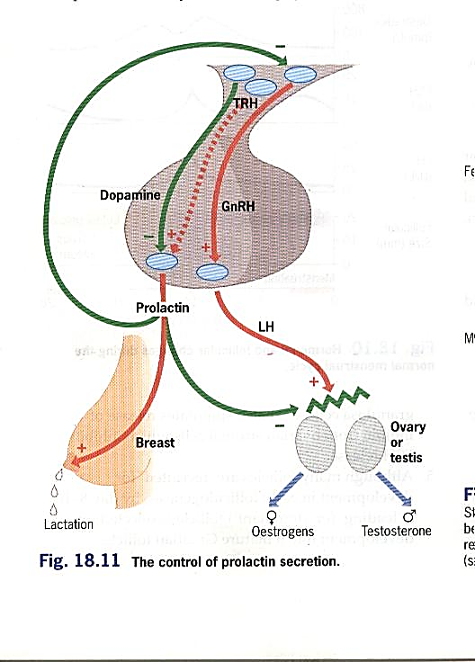
*Hypothalamus inhibits prolactin secretion

Slide 18
Throughout pregnancy
  Oestrogen, progesterone & prolactin stimulate breast growth
  Oestrogen (& progesterone) antagonize milk production effect of prolactin
After parturition, abrupt drop in oestrogen and progesterone initiates lactation
Prolactin stimulates breast milk production
Thereafter, oestrogen antagonizes action of prolactin

Slide 19
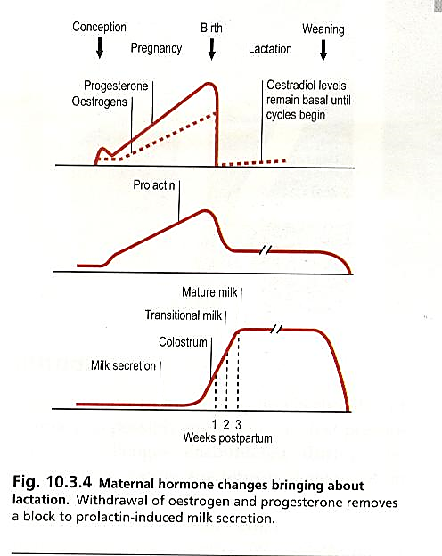

Slide 20
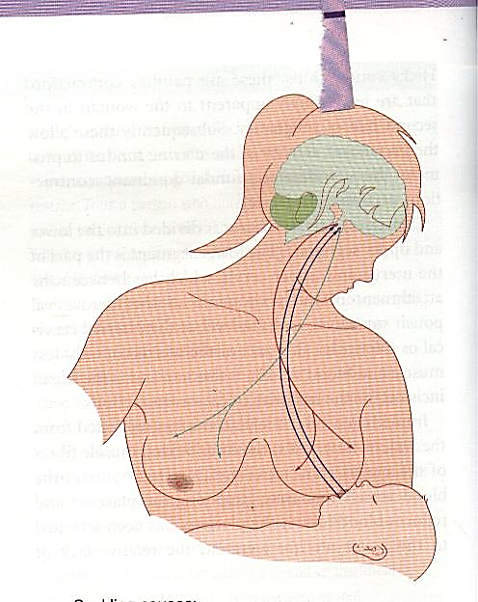
Breast milk ejection
Milk in the alveoli is “let down” to the ducts only at certain times (eg. Suckling, emotions)
Stimulated by oxytocin - neural reflex; which causes contraction of the myoepithelial cells
Oxytocin is essential for milk ejection in humans

Slide 21
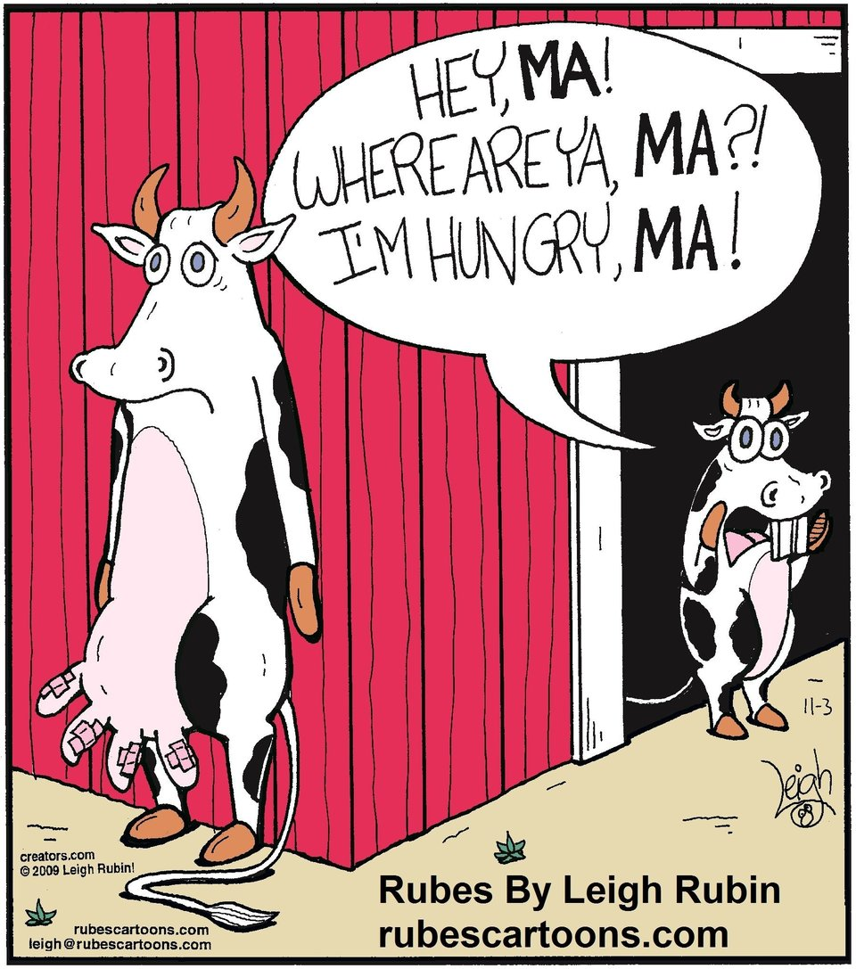

Slide 22
Summary
Mechanism of parturition
  Hormonal – oxytocin, oestrogens & progesterone
  mechanical
Stages of delivery
Pain in parturition
Post-partum period
Lactation
  Prolactin, oxytocin

